Slide 1
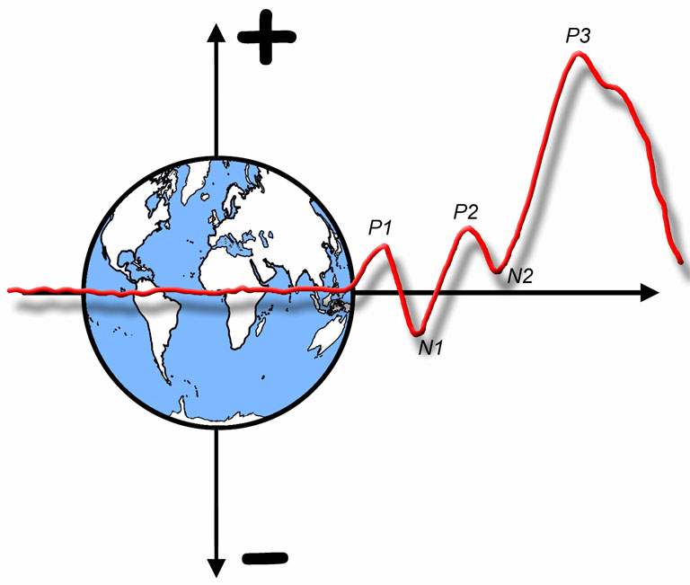

The ERP Boot Camp
Setting up and Running an ERP Lab

Slide 2
Recording Chamber
Do you really need one?
Probably not if:
You’re looking at slow components and can low-pass filter with a 50% cutoff at 30 Hz
And you’re not near any major source of electrical noise
Elevators, centrifuges, power transformers, ventilation fans
You don’t care about gamma oscillations
Or you have active electrodes
They’re good for keeping subjects focused
They tend to get warm, so it may actually be better not to have one if skin potentials are a major source of noise
You can build one from 2x4’s and copper screen
Notes:
© S. J. Luck. All Rights Reserved. May be used for nonprofit educational purposes if this copyright notice is included. Permission must be obtained from the copyright holder(s) for any other use.

Slide 3
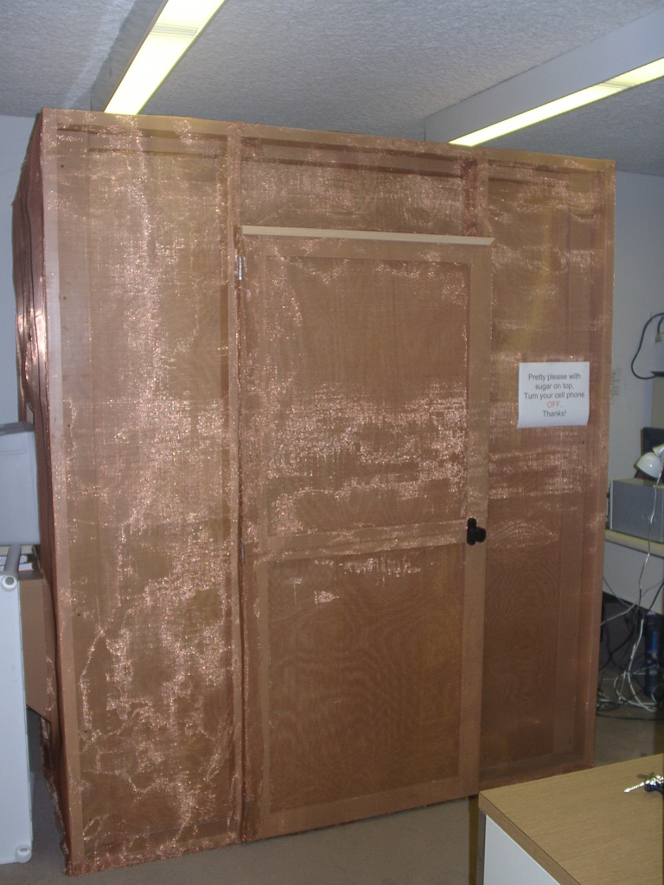
Courtesy of Lynne Reder
Notes:
© S. J. Luck. All Rights Reserved. May be used for nonprofit educational purposes if this copyright notice is included. Permission must be obtained from the copyright holder(s) for any other use.

Slide 4
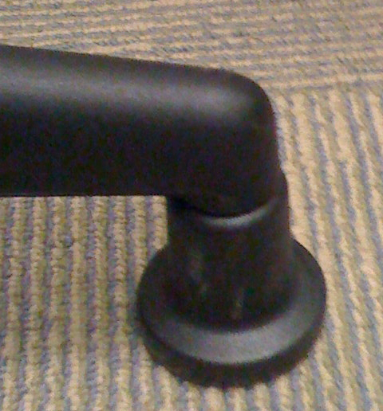
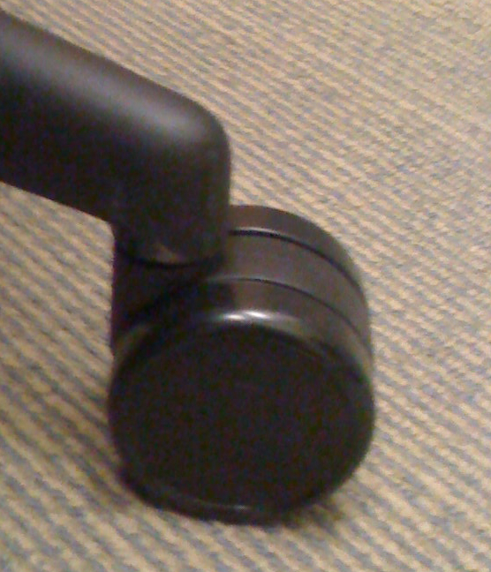
Seating
Key points:
Comfortable to avoid muscle noise
Don’t want subjects to fall asleep
Don’t want electrodes to rest on anything
Recliners were once common
Not good if you have electrodes over the back of the head
I recommend high-quality office chair
Glides rather than wheels
Mark the floor
I haven’t had much luck with chin rests
Notes:
© S. J. Luck. All Rights Reserved. May be used for nonprofit educational purposes if this copyright notice is included. Permission must be obtained from the copyright holder(s) for any other use.

Slide 5
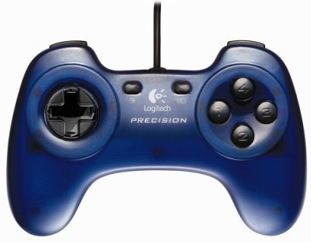
Response Devices
Need to be held in a comfortable position
Don’t want subject holding arms up
Standard computer keyboards are bad
Game controllers work well
Mass-produced -> reliable
Constant and variable timing errors are possible
RT is so variable that a bit of timing variability will usually have virtually no impact (unless you are looking at response-locked averages)
Ulrich, R., & Giray, M. (1989). Time resolution of clocks: Effects on reaction time measurement—Good news for bad clocks. British Journal of Mathematical and Statistical Psychology, 42, 1-12.
EMG for best response timing
Can measure timing errors by putting a mic next to device and recording “click” along with event code
Notes:
© S. J. Luck. All Rights Reserved. May be used for nonprofit educational purposes if this copyright notice is included. Permission must be obtained from the copyright holder(s) for any other use.

Slide 6
Hints for Running Subjects
~60 minutes of “run time” per session
More for interesting experiments
Whole session is about 3 hours
Runs of 4-6 minutes with 2-3 20-second breaks
Less makes it inefficient to deal with electrodes, etc.
More leads to fatigue
Some labs do all-day sessions with lot of breaks
Dilution Rule: Don’t dilute good data with bad data
Adding noisy trials doesn’t improve the S/N ratio
Watch the EEG throughout the session
Look for artifacts, bad connections, etc.
Watch the subject with a video camera
Notes:
© S. J. Luck. All Rights Reserved. May be used for nonprofit educational purposes if this copyright notice is included. Permission must be obtained from the copyright holder(s) for any other use.
Backpack for experimenter
Cell phone for subject or experimenter
Sound proofing versus masking noise

Slide 7
Hints for Running Subjects
Happiness Rule: A happy subject is a good subject
Compliance with task
Compliance with artifact control instructions
Less noise
Talking to subjects
Treat subject like a person, not like a piece of meat
Chat while putting on electrodes (or video)
Tell them exactly what will happen -- this reduces stress
Chat during breaks
Note: Some subjects don’t want to talk -- that’s OK
Keeping subjects happy
Food and drink (is caffeine a confound?)
Eye drops (single-use)
Music
Notes:
© S. J. Luck. All Rights Reserved. May be used for nonprofit educational purposes if this copyright notice is included. Permission must be obtained from the copyright holder(s) for any other use.

Slide 8
Looking at the Data
Do a fairly complete analysis of the first subject’s data before running anyone else
All the main comparisons among ERP waveforms
Accuracy (and RT if recorded) for each main condition
There may be a serious problem with event codes, etc.
Nothing focuses the mind quite as much as real data
Take a look at the individual subjects and the grand averages every 3-4 subjects
Grand averages will give you more power to see something funky in the data
But don’t get too freaked out if the results look a little funny or aren’t conforming to your predictions
Be especially concerned about “impossible” results (e.g., effects that consistently begin before time zero)
Notes:
© S. J. Luck. All Rights Reserved. May be used for nonprofit educational purposes if this copyright notice is included. Permission must be obtained from the copyright holder(s) for any other use.

Slide 9
Looking at the Data
When you do stats
Have your stats program print a table of means
Compare the means with your grand averages
Notes:
© S. J. Luck. All Rights Reserved. May be used for nonprofit educational purposes if this copyright notice is included. Permission must be obtained from the copyright holder(s) for any other use.

Slide 10
Ethical Issues
Everything that applies to behavioral experiments plus…
Risk of disease transmission
High impedance helps (because abrasion is not needed)
Need thoughtful disinfection (even for high impedance)
Risk of electrical shock
Optical isolation and/or battery power
Headache from electrode cap
Gel in hair
Long duration of experiment
Claustrophobia
Concerns about privacy of EEG data
Providing clear information in advance is the best way to prevent problems
Also: Don’t fish for p values
Notes:
© S. J. Luck. All Rights Reserved. May be used for nonprofit educational purposes if this copyright notice is included. Permission must be obtained from the copyright holder(s) for any other use.

Slide 11
CRT Basics
Notes:
Figure 8.3 from Luck, Steven J. (2005). An introduction to the Event-Related Potential Technique. Cambridge, MA: MIT Press.© MIT Press. This material may be used for nonprofit research and education purposes only, and it may not be reprinted or distributed in any form including print and electronic forms.
Other content: © S. J. Luck. All Rights Reserved. May be used for nonprofit educational purposes if this copyright notice is included. Permission must be obtained from the copyright holder(s) for any other use.

Slide 12
Stimulus Presentation
Testing the timing of event codes
Digitize at ~1000 Hz
Point some kind of light-sensitive device to the video monitor and connect to digitization system
Measure from the upper left corner of the monitor
Also try other locations to assess delay
Present stimuli with event codes and record the stimulus
See when the stimuli are actually presented relative to the event codes
Notes:
© S. J. Luck. All Rights Reserved. May be used for nonprofit educational purposes if this copyright notice is included. Permission must be obtained from the copyright holder(s) for any other use.

Slide 13
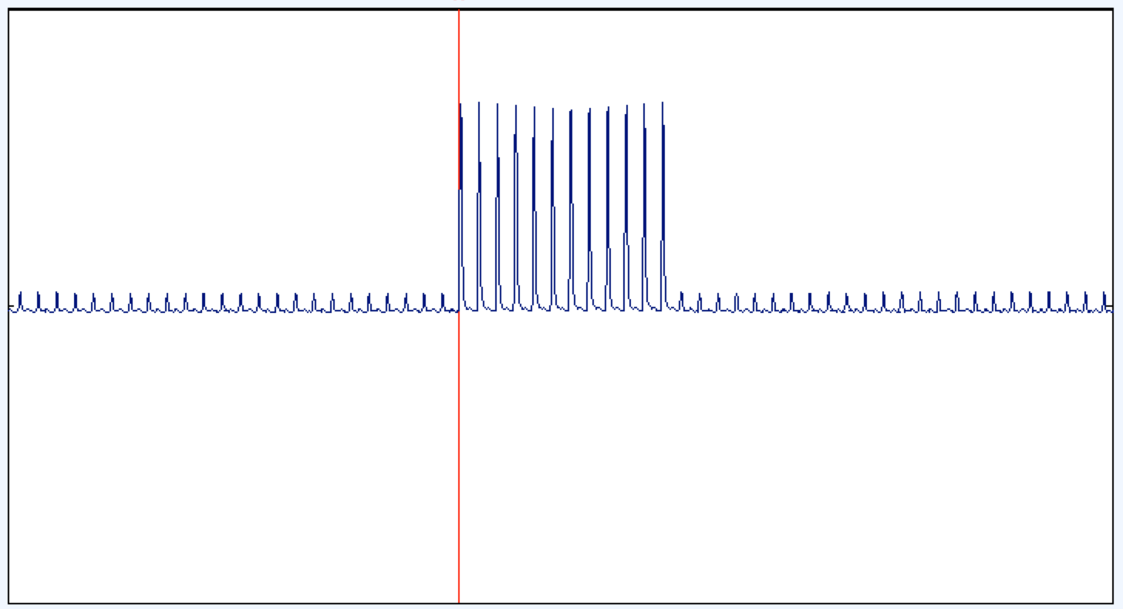
CRT Test
Notes:
© S. J. Luck. All Rights Reserved. May be used for nonprofit educational purposes if this copyright notice is included. Permission must be obtained from the copyright holder(s) for any other use.

Slide 14
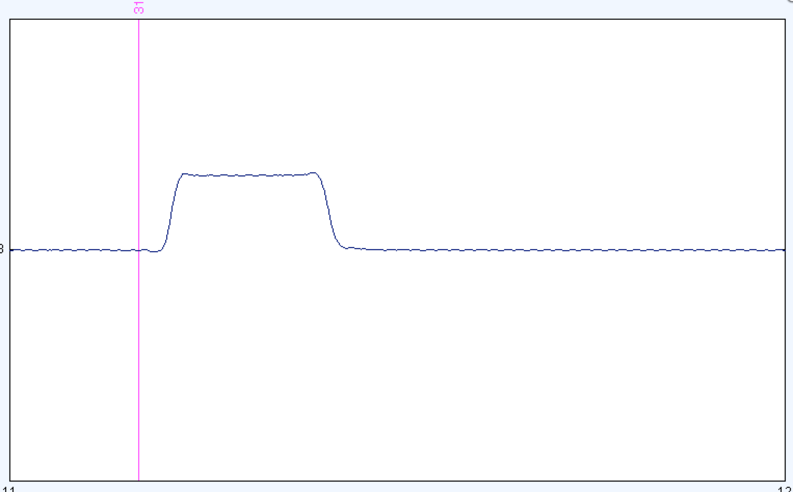
LCD Test
Notes:
© S. J. Luck. All Rights Reserved. May be used for nonprofit educational purposes if this copyright notice is included. Permission must be obtained from the copyright holder(s) for any other use.

Slide 15
Auditory Stimulus Presentation
Auditory artifacts
Speaker in headphones may induce a current in your electrodes/wires
Post-auricular muscle twitch
Testing the timing of event codes
Digitize at fastest possible rate (e.g., 10KHz)
Connect auditory output (or a microphone) to the digitization system
You might want to use a square-wave tone or a 50-Hz sine wave
Present stimuli with event codes and record the stimulus
See when the stimuli are actually presented relative to the event codes
Notes:
© S. J. Luck. All Rights Reserved. May be used for nonprofit educational purposes if this copyright notice is included. Permission must be obtained from the copyright holder(s) for any other use.

Slide 16
Auditory Stimulus Presentation
Look for constant and variable delays
Notes:
© S. J. Luck. All Rights Reserved. May be used for nonprofit educational purposes if this copyright notice is included. Permission must be obtained from the copyright holder(s) for any other use.

